Slide 1
Laptop price prediction using ai
-DEEPTHI.KOLHAR- 2OETIS411010
-ADHYA GANESH GK- 20ETIS411403
-KEERTHANA RJ – 20ETIS411

Slide 2
INTRODUCTION
Artificial intelligence (AI) and machine learning (ML) are rapidly transforming the world we live in today, with countless applications in nearly every industry. AI refers to the ability of machines to perform tasks that typically require human intelligence, such as learning, reasoning, and problem-solving.
Machine learning, on the other hand, is a subset of AI that involves training algorithms to learn from data and improve their performance over time.
Laptop price prediction involves the use of machine learning algorithms and statistical models to forecast the price of a laptop based on a variety of factors such as specifications, brand, market trends, and more. The goal of laptop price prediction is to provide consumers and retailers with an accurate estimate of the value of a laptop at any given time, which can inform purchasing decisions, inventory management, and more.

Slide 3
INTRODUCTION
To make accurate predictions, machine learning algorithms can be trained on historical data about laptop prices, as well as other relevant factors such as consumer reviews, competitor prices, and market trends. This data is used to create a model that can then be used to predict the price of a laptop based on new data input.
There are various machine learning techniques that can be used for laptop price prediction, including regression analysis, decision trees, and neural networks. The accuracy of the predictions depends on the quality and quantity of data used, as well as the complexity of the model.
Overall, laptop price prediction is a useful tool for consumers and retailers alike, allowing for more informed purchasing decisions and better management of inventory and pricing strategies.

Slide 4
APPLICATIONS OF PRICE PREDICTION
ONLINE MARKETPLACES- E-commerce platforms that sell laptops can use price prediction models to forecast prices and adjust them in real-time to maximize profits and competitiveness
INVENTORY MANAGEMENT-Retailers can use laptop price prediction models to optimize their inventory management and ensure they have the right amount of stock on hand at all times.
CONSUMER RESEARCH-:Researchers can use laptop price prediction models to better understand consumer behavior and preferences, including which features and specifications are most important to them and how they impact price.
FINANCIAL ANALYSIS-Financial analysts can use laptop price prediction models to evaluate the performance of companies that manufacture or sell laptops, as well as forecast future earnings and growth potential.
PRICE COMPARISON WEBSITES-Websites that compare laptop prices across different retailers can use price prediction models to provide more accurate and up-todate information to their users.

Slide 5
DATA OPTIMISATION-refers to the process of improving the quality and usability of data for a specific task
Data cleaning:Data cleaning typically involves several tasks such as removing duplicate records, filling in missing values, correcting spelling and formatting errors, and removing outliers.
Data validation: Data helps to ensure that the data is of high quality, which in turn can improve the accuracy and reliability of any subsequent data analysis or decision-making based on the data.
Feature selection: Data helps to ensure that the data is of high quality, which in turn can improve the accuracy and reliability of any subsequent data analysis or decision-making based on the data.
Data visualization: Data visualization is the process of presenting data in a graphical or visual format to help identify patterns, trends, and relationships in the data
Data analysis: The main objective of data analysis is to uncover insights and information from the data that can be used to improve processes, make better decisions, and drive business outcomes
Data normalization: Data normalization :data normalization is to reduce the impact of differences in scale and distribution among the variables, which can affect the accuracy and performance of analytical models.
Data modeling: data modeling is to identify patterns and relationships in the data that can be used to predict future outcomes or behavior. It involves various steps such as feature selection, model selection, training, and evaluation.
Model optimization: model optimization is to improve the performance and reliability of a predictive model, which can help to drive better business outcomes and make more informed decisions. It involves various techniques such as cross-validation, grid search, and random search.

Slide 6
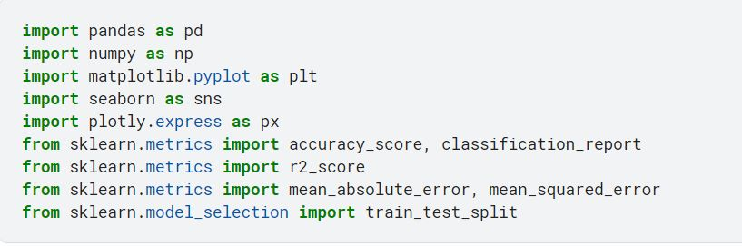
IMPORTING LIBRARIES:

Slide 7
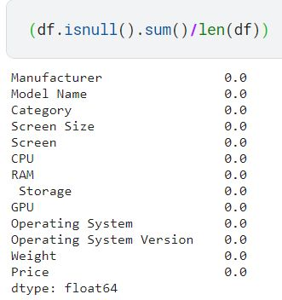
DATA CLEANING AND VALIDATION
The null values are replaced with the mode value.
Each column is checked for null values.

Slide 8
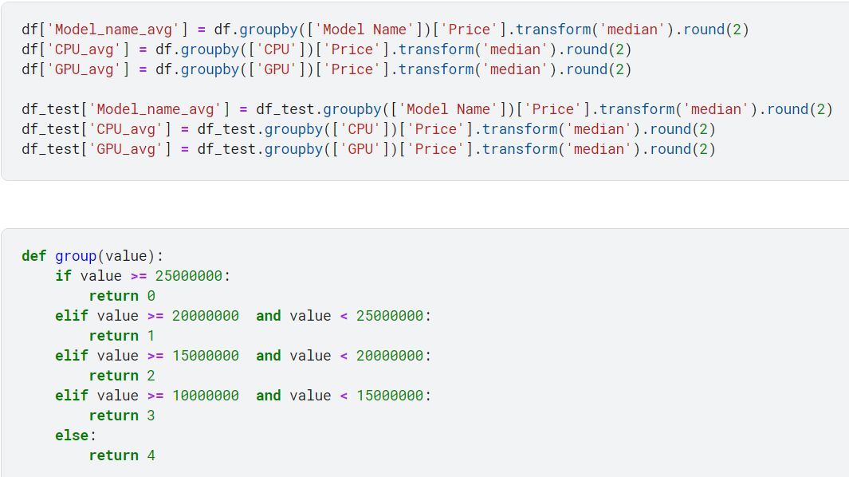
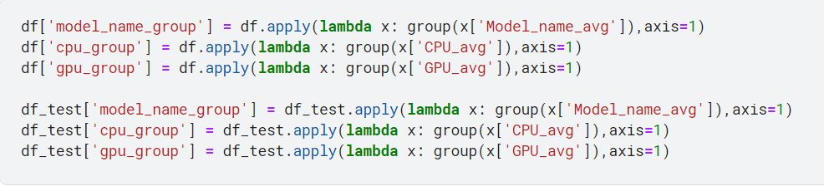
Creating new columns and converting categorical data to numerical data

Slide 9
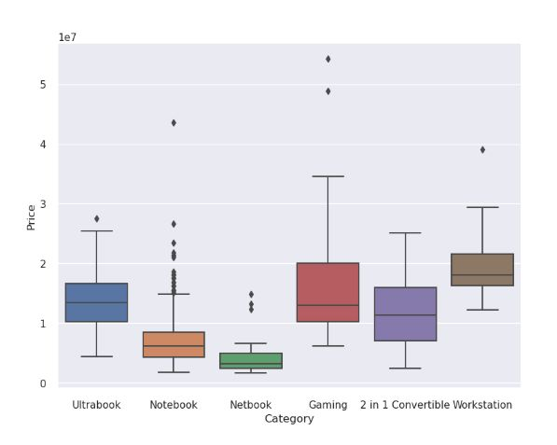
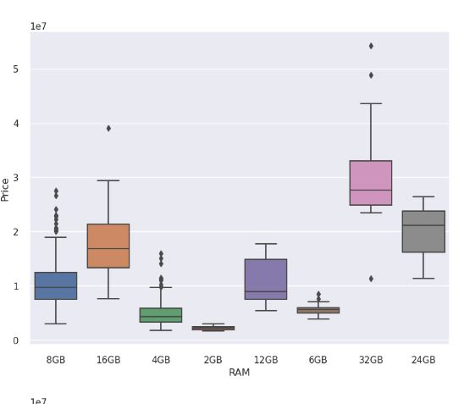
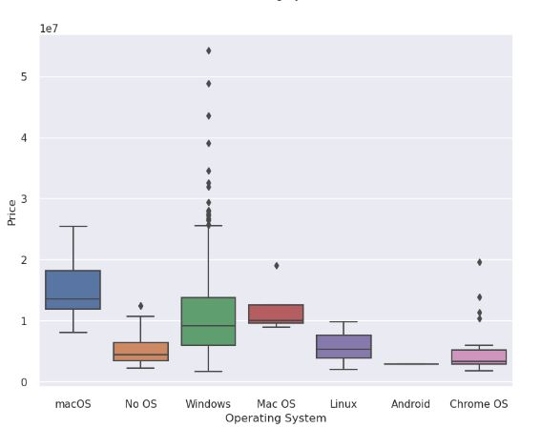
VISUALISATION
BOX PLOTS: depicting the distribution of each of the independent variables with respect to price.

Slide 10
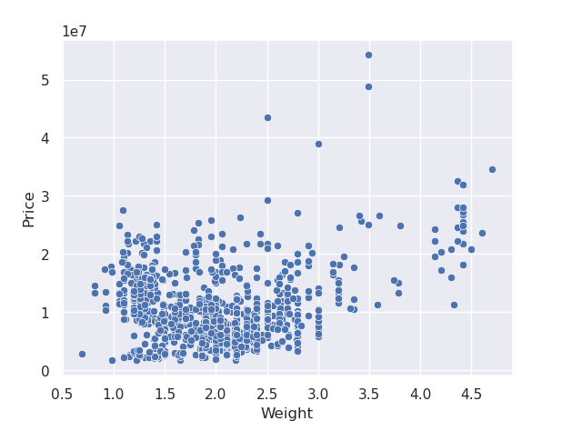
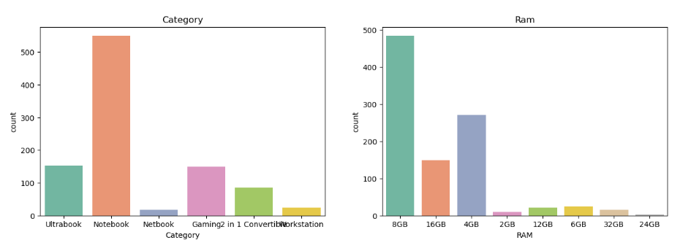
Scattered plot depicting the weights with respect to price.
Bar graphs depicting the count of each category of laptops and the ram.
Here we see that in category notebook are of highest count and in ram 8GB is of highest count or stock.

Slide 11
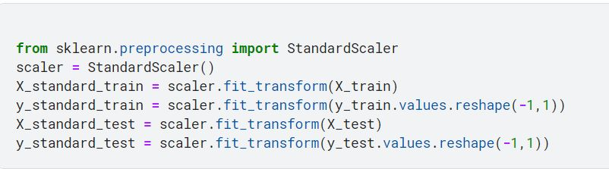
NORMALISATION
Here the values in the dataset are standard scaled to bring about more accuracy and help the model to do a better job.

Slide 12
MODEL SELECTION
model selection involves choosing the best machine learning algorithm or model that can accurately predict the price of a laptop based on the given input features. It is an iterative process that involves training and evaluating multiple models to select the best one for the task.
Here we have done all cleaning ,featuring, splitting etc.
2 models used:
Linear regression
Random forest regressor

Slide 13
LINEAR REGRESSION
Regression models are used to predict the value of a dependent variable based on the values of one or more independent variables.
The most common type of regression model is linear regression, which assumes a linear relationship between the dependent variable and the independent variables. In linear regression, the model estimates the coefficients of the independent variables that best fit the data to the line of best fit. The equation of the line of best fit is then used to make predictions on new data.

Slide 14
LINEAR REGRESSION
Fitting a linear regression model to a laptop price prediction problem involves estimating the coefficients of the independent variables that best fit the data to a linear equation. In other words, we are trying to find the line of best fit that explains the relationship between the dependent variable (price) and the independent variables (laptop features such as processor type, RAM, hard disk capacity, graphics card, brand, etc.).The equation of a simple linear regression model is:
y = β0 + β1x + ε
where y is the dependent variable (price), x is the independent variable (laptop feature), β0 is the intercept, β1 is the coefficient or slope, and ε is the error term. The goal of the linear regression model is to estimate the values of β0 and β1 that minimize the sum of squared errors between the predicted values and the actual values.

Slide 15
RESULT :
Train accuracy: 0.8387595187152533
Test accuracy : 0.7935316574237211
Mean Absolute Error : 1953117.081047944
Root Mean Square Error : 2696368.1093766172

Slide 16
RANDOM FOREST REGRESSOR
Random Forest algorithm: a number of decision trees on various subsets of the given dataset and takes the average to improve the predictive accuracy of that dataset.
2.why we use random forest: It takes less training time ,predicts output with high accuracy
3.how random forest algorithm works: It combining N decision tree, and it make predictions for each tree created in the first phase.
4. Applications:Banking,Medicine,Land use, Marketing
5.Advantages:performing both Classification and Regression tasks, enhances the accuracy, handling large datasets with high dimensionality.
6.Disadvantages:It can be used for both classification and regression tasks, it is not more suitable for Regression tasks.Implementation:Data Pre-processing,stepFitting the Random forest algorithm to the Training set, Predicting the test result, Test accuracy of the result (Creation of Confusion matrix),Visualizing the test set result.

Slide 17
RESULT:
Train accuracy : 0.957658607401638
Test accuracy: 0.8180228352184167
Mean Absolute Error : 1816206.923974398
Root Mean Square Error : 2531400.68590522
CONCLUSION:
Based on the results obtained we see that the random forest regressor has the better testing accuracy and fits the best into our model.

Slide 18
CONCLUSION ON MODEL SELECTION
Based on the results obtained we see that the random forest regressor has the better testing accuracy and fits the best into our model.

Slide 19
PROBLEM AREA
Lack of data: Without enough data or with data that is inaccurate or incomplete, the accuracy of the predictions can be compromised
Feature selection: determining which features are most important can be difficult, and selecting too few or too many features can lead to inaccurate predictions.
Overfitting: Overfitting occurs when a model is too complex and trained on too few data points, leading to it memorizing the training data instead of generalizing. This can result in poor performance when predicting laptop prices on new, unseen data.
Changing market conditions: The laptop market is constantly evolving, with new models and technologies being introduced regularly. This can make it challenging to keep laptop price prediction models up-to-date and accurate over time.

Slide 20
Interpretability: Some AI models used for laptop price prediction can be complex and difficult to interpret. This can make it challenging to understand how the model arrived at its predictions, making it harder to refine the model and correct any inaccuracies.

